Slide 1
Automobile Industry analysis
Navigating India's Electric Vehicle Revolution

Slide 2
Background
Rapidly Evolving Market & Strategic Importance:
The Indian EV market is undergoing a significant and rapid transformation, driven by global sustainability trends and national imperatives. It's no longer a niche segment but a critical component of India's future economy and infrastructure.
Understanding this evolving landscape is crucial for strategic decision-making by manufacturers, investors, policymakers, and businesses operating within or looking to enter this sector.
Environmental Sustainability & Energy Security:
India faces significant challenges with air pollution in its major cities and a high dependence on crude oil imports (around 80% of its requirements).
EV adoption is a cornerstone of India's commitment to reducing carbon emissions, combating climate change, and enhancing energy security by shifting towards indigenous and renewable electricity sources. This analysis helps track progress towards these critical national goals.
Competitive Landscape & Maker Performance:
The market is becoming increasingly competitive with both established auto giants and new EV-focused players.
Evaluating maker performance and their respective growth rates helps understand market share shifts, competitive advantages, and areas for strategic differentiation.

Slide 3
PROBLEM STATEMENT
As a part of AtliQ Motors expansion plans, they wanted to launch their bestselling models in India where their market share is less than 2%.
Business Objective
Detailed market study of existing EV/Hybrid market in India.
Establish AltliQ Motors as an Automobile Giant in Indian market too.

Slide 4
PROJECT OVERVIEW
SCOPE OF ANALYSIS
Makers Performance Analysis
State Wise Adoption & Penetration
Seasonal Trends & Future Projections
DATASETS
Dim_date
Makers_sales
States_sales

Slide 5
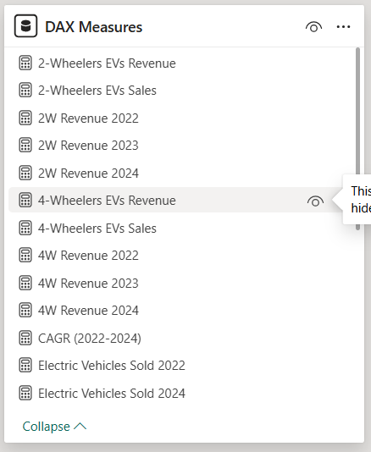
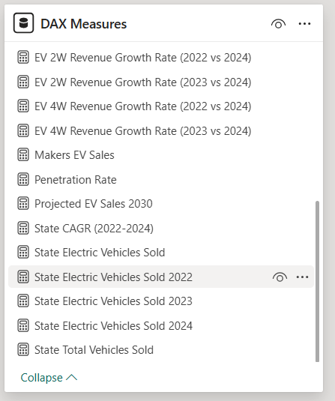
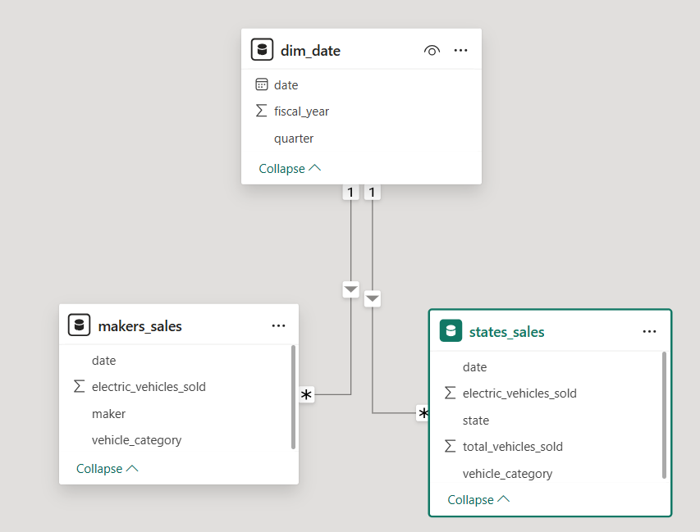
DATA MODEL
MANY TO ONE RELATIONSHIPS

Slide 6
Primary questions
Decoding India's Electric Vehicle Market: Essential Analysis and Findings

Slide 7
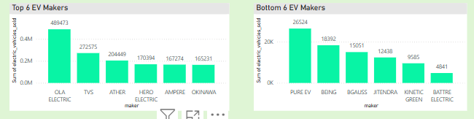
1. List the top 6 and bottom 6 makers for the fiscal years 2023 and 2024 in terms of the number of 2-wheelers sold

Slide 8
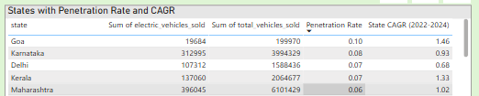
2. Identify the top 5 states with the highest penetration rate in 2-wheeler and 4-wheeler EV sales in FY 2024.

Slide 9
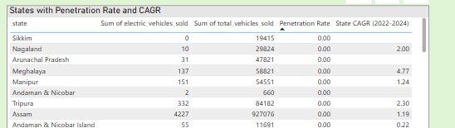
3. List the states with neutral penetration in EV sales from 2022 to 2024?

Slide 10
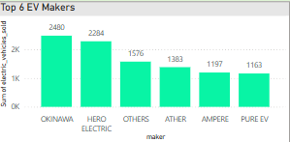
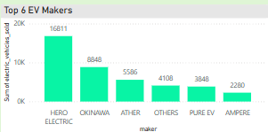
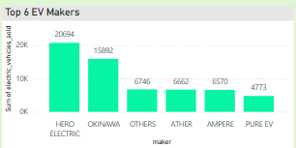
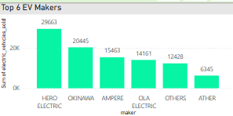
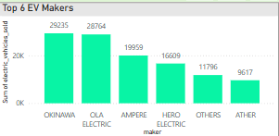
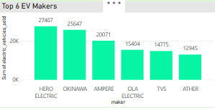
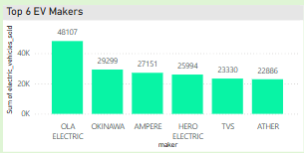
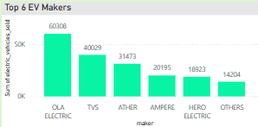
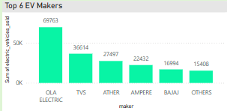
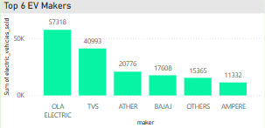
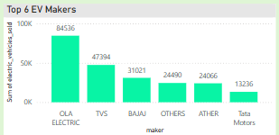
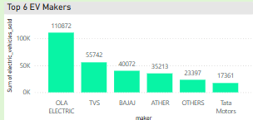
4. What are the quarterly trends based on sales volume for the top 6 EV makers from 2022 to 2024?

Slide 11
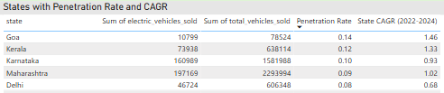
5. How do the EV sales and penetration rates in Delhi compare to Karnataka for 2024?
Karnataka stands 3rd Place and Delhi stands 5th Place in the Penetration Rates

Slide 12
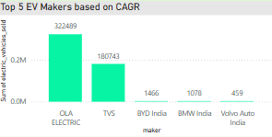
6. List down the compounded annual growth rate (CAGR) in 4-wheeler units for the top 5 makers from 2022 to 2024.

Slide 13
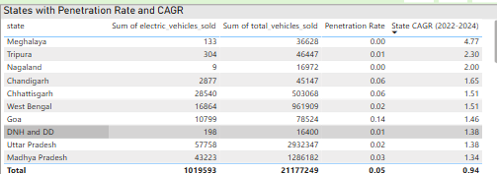
7. List down the top 10 states that had the highest compounded annual growth rate (CAGR) from 2022 to 2024 in total vehicles sold

Slide 14
RECOMMENDATIONS
Launch 2 Wheelers and 4 Wheelers in Entry Level Segments which would create an strong wish-lists for the entry level buyers
Focus on crowded states like Uttar Pradesh to sell the vehicles more
To support Long drives, Install Charging facilities in our ideal vehicle’s drive range. Start with the states which have highest EV vehicles Selling Market. This step will increase the Brand value among the customers and increase our customer market

Slide 15
Thank you

